Slide 2
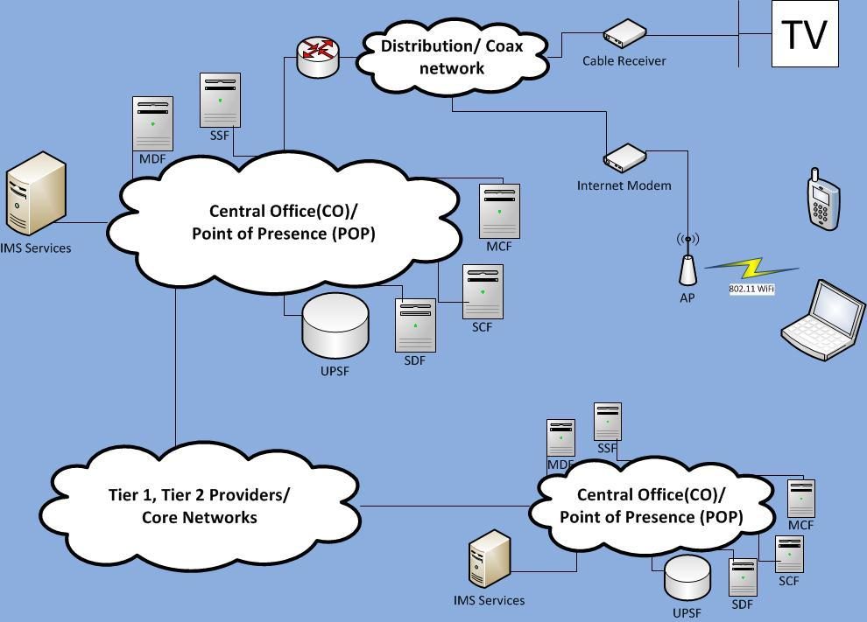

Slide 3
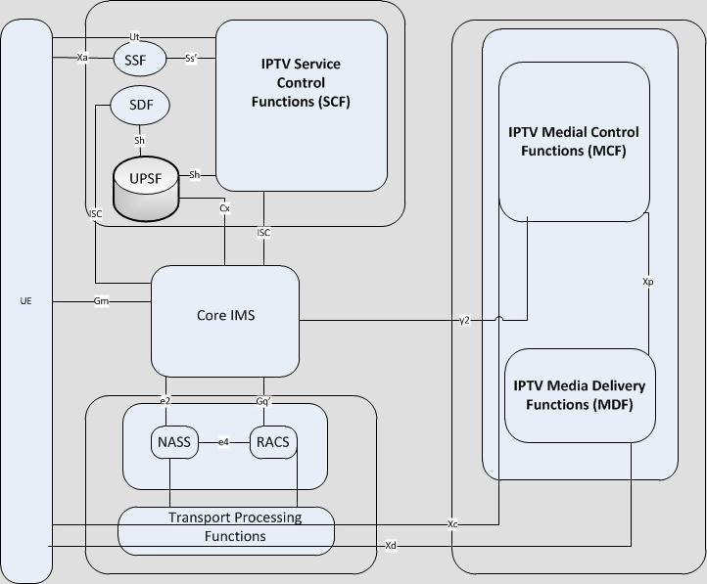
Describe in detail your design (text, diagrams, screenshots, etc). Use BPMN if possible.
Key
Ut= service profile config.
ES 282 007 [11]
Ss'= exchange service info. and/or Service Provider info.
Sh= ES 282 007 [11]
Cx= ES 282 007 [11]
ISC= ES 282 007 [11]
Gm= ES 282 007 [11]
e2= App. Function - NASS
ES 282 007 [11], ES 282 004 [3]
e4= ES 282 003 [8], ES 282 004 [3]
y2= Carry Service Control signalling from SCF to control MCF
Gq'= ES 282 007 [11],
ES 282 003 [8]
Xa= used by UE to make appropriate service selections
Xc=exchange media control messages for control of Media flow ES282 001 [1]
Xd = used to deliver media data ES 282 001 [1]
Xp = used to control media delivery sessions to support media delivery session setup
* IPTV Diagram from
ETSI TS 182-027

Slide 4
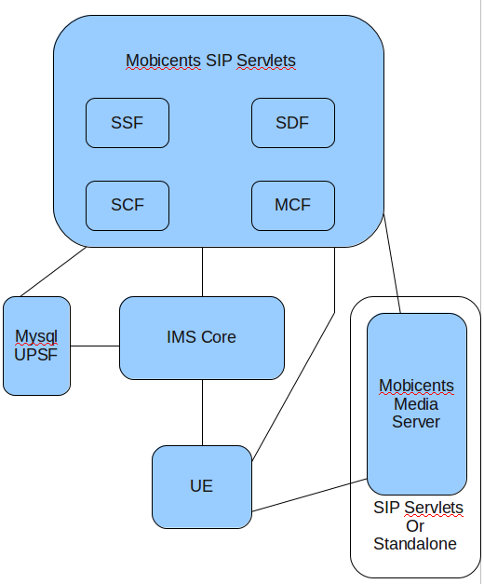
Design Plan

Slide 5
Design Description
Goals:
Create an IPTV service REQUIRED:
- user registration
- live-streaming channel selection
WANTING TO EXPLORE:
- adaptive stream quality depending on network conditions
- customized advertisement based on user profile
Service Components to be Created:
SDF
SSF
SCF
MCF
UE Client
Service Components Provided:
Mobicents Media Server (with JSR 309 API)
UPSF (using mysql database)
IMS Core (OpenIMS)

Slide 6
SWOT analysis
Strengths
Weaknesses | Design doesn't include
Opportunities | - Adding functionality can diversify markets beyond the technical sphere of influence.
Threats | - Existing implementations of IPTV are fully functional e.g. Cisco implementation of IPTV

Slide 7
Tasks
1. Set up development environment with source control. (Yuri)
-need an environment where team mates can checkout/checkin and
test code from their home.
2. Document interfaces and functionality of our customized service
function and client software. (Group Effort)
3. Analyze and distribute development workload (Group Effort)
4. SDF Development. (Nikhil)
5. SCF Development. (Nishant)
6. SSF Development. (Nikhil)
7. MCF Development. (Yuri)
8. MDF Development (Yuri)
9. UE Client Development. (Group Effort)
10. Test the design and look for possible improvements in functionality (Group Effort)

Slide 8
List all the tasks that you need to implement and resources required.

Slide 9
Detailed plan of work, i.e., tasks, order of execution, manager, and anticipated time of completion.

